Slide 1
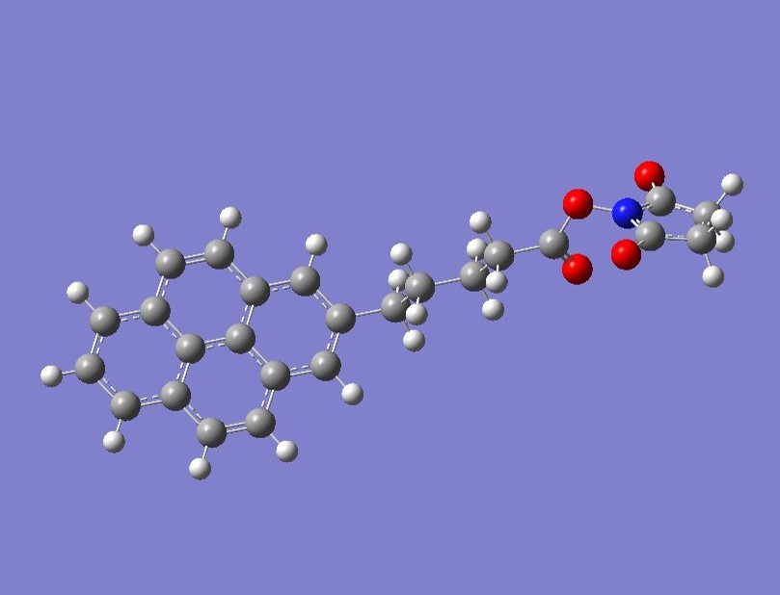
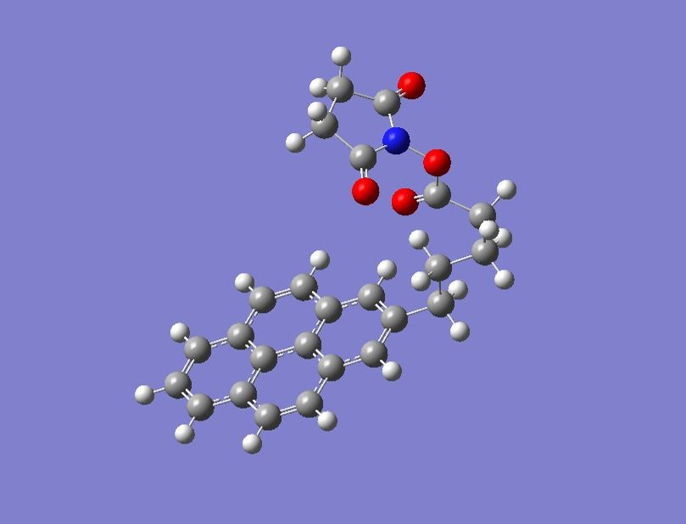

Slide 2
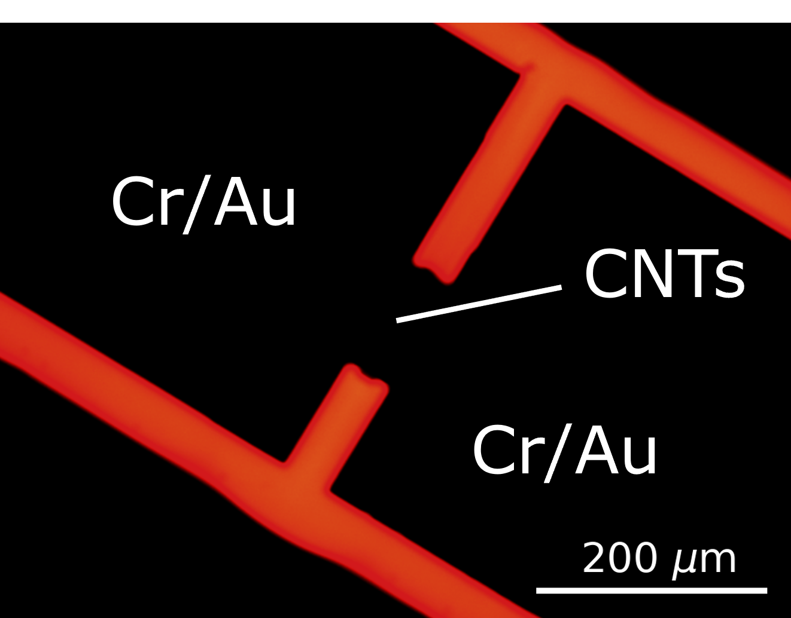
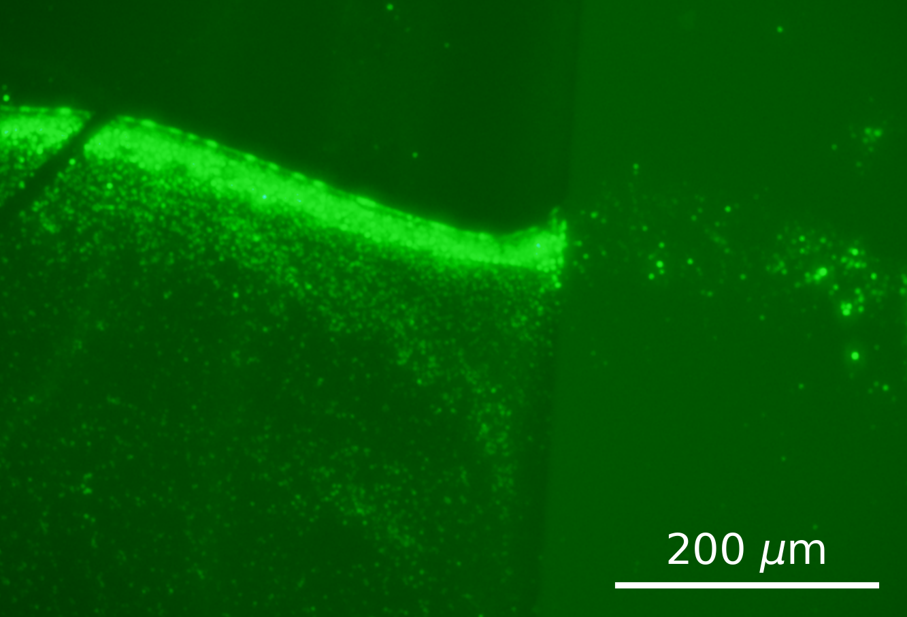
Ti/Au
SiO₂
SiO₂
Ti/Au

Slide 3
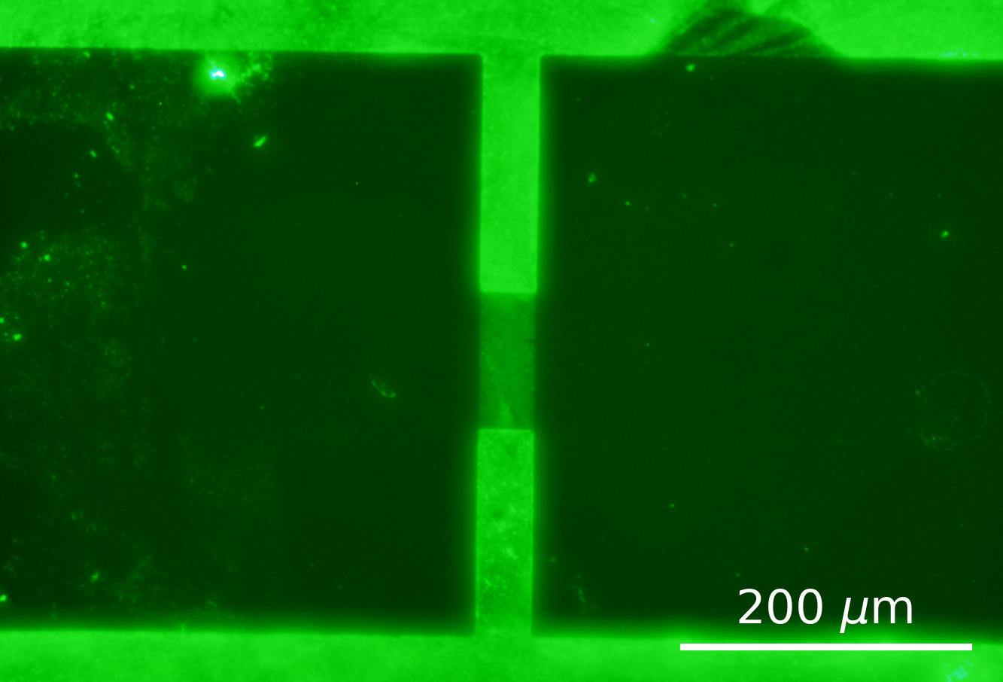
SiO₂
CNTs
Ti/Au
Ti/Au

Slide 4
SiO₂
CNTs
Ti/Au
Ti/Au

Slide 5
SiO₂
CNTs
Ti/Au
Ti/Au

Slide 6
SiO₂
CNTs
Ti/Au
Ti/Au

Slide 7
SiO₂
CNTs
Ti/Au
Ti/Au

Slide 8
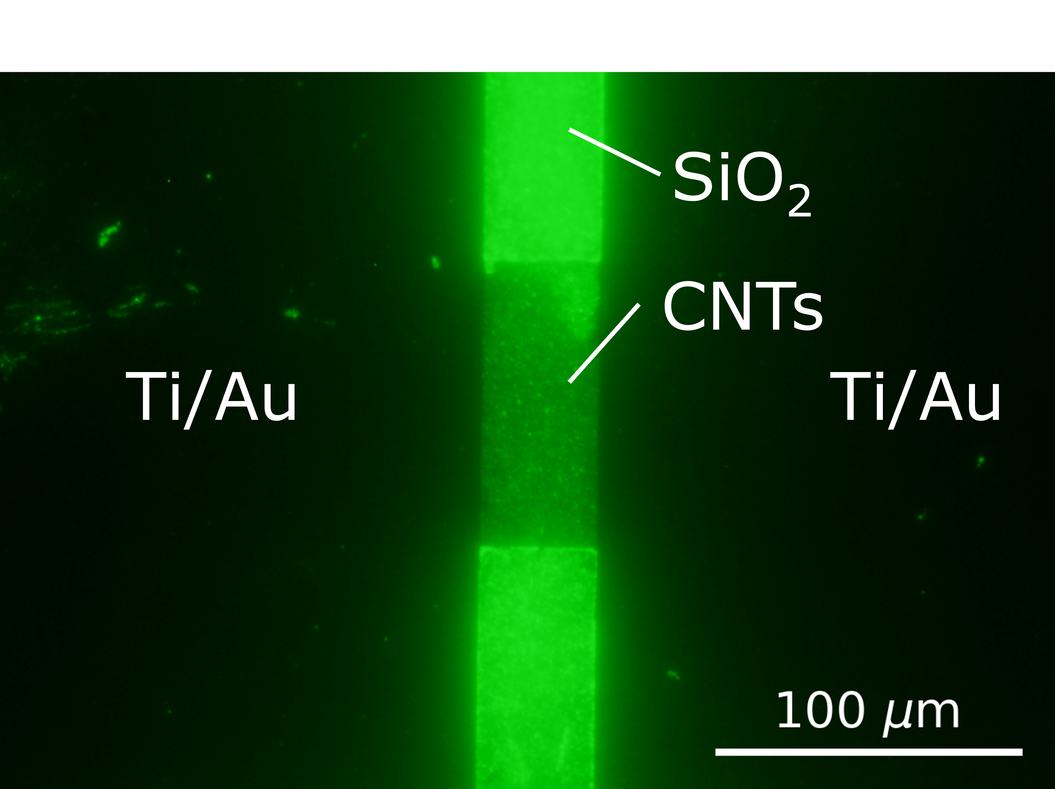

Slide 10
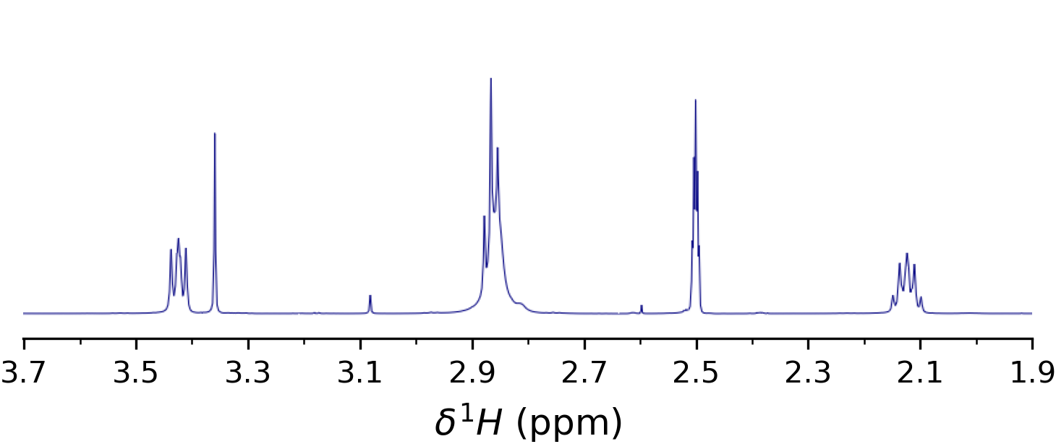
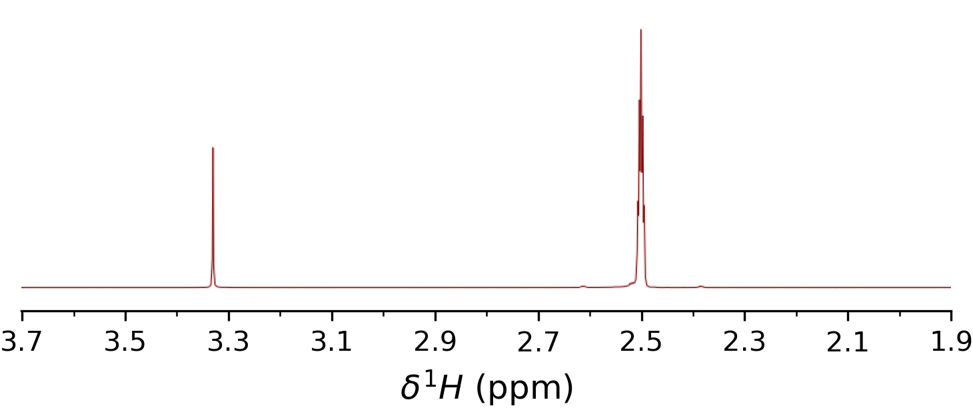
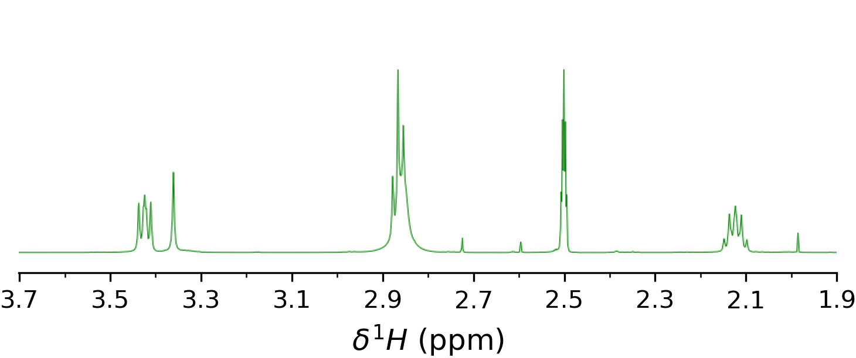
DMSO
H₂O
PBASE
DMSO
PBASE
H₂O
PBASE
PBASE
DMSO
PBASE
H₂O
PBASE

Slide 11
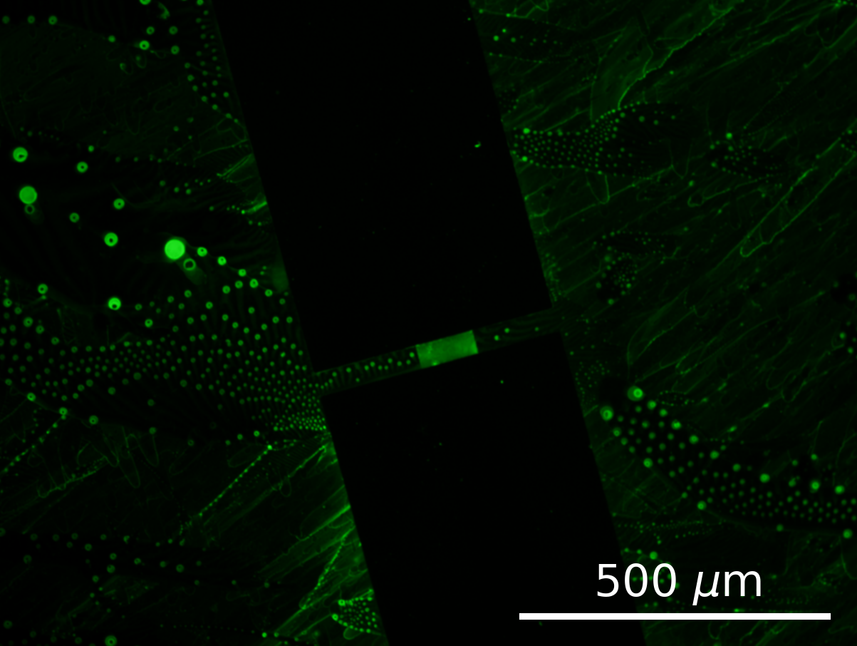
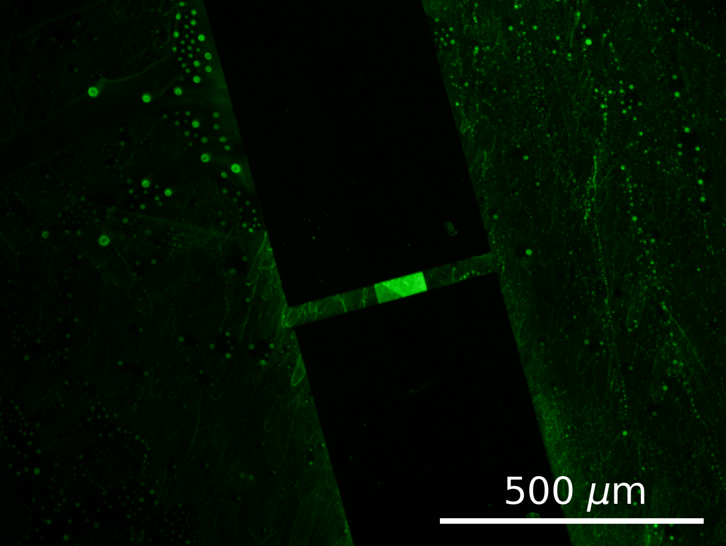
SiO₂
SiO₂
Ti/Au
Ti/Au
Graphene
Graphene
Ti/Au
Ti/Au
SiO₂
SiO₂

Slide 12
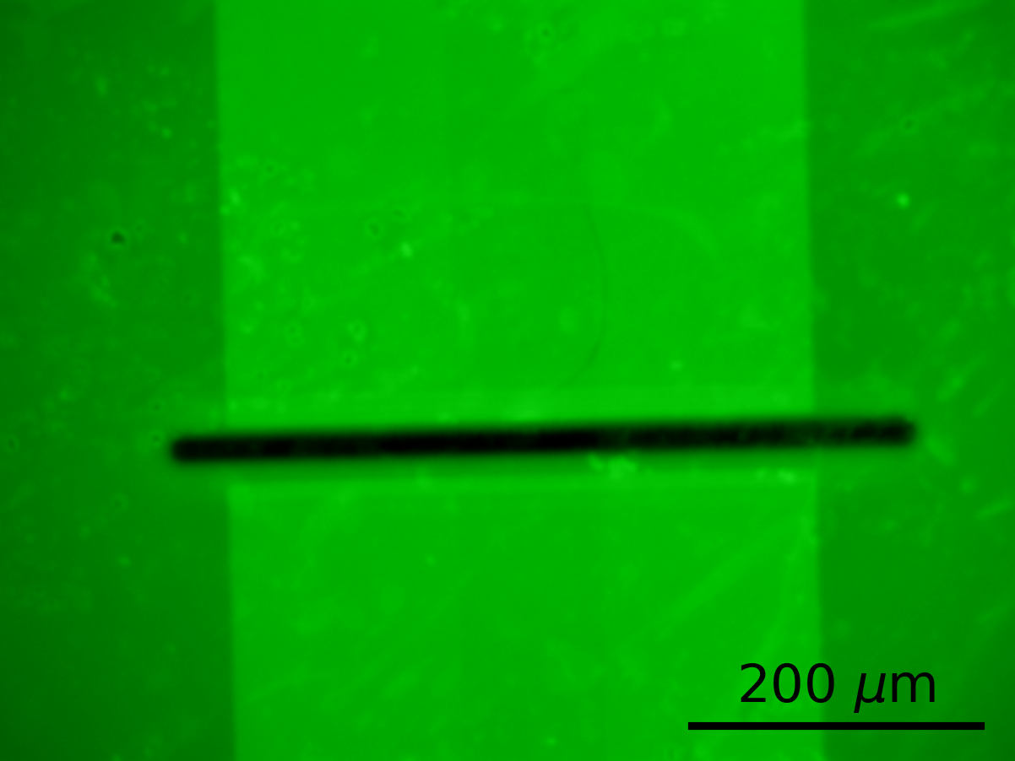
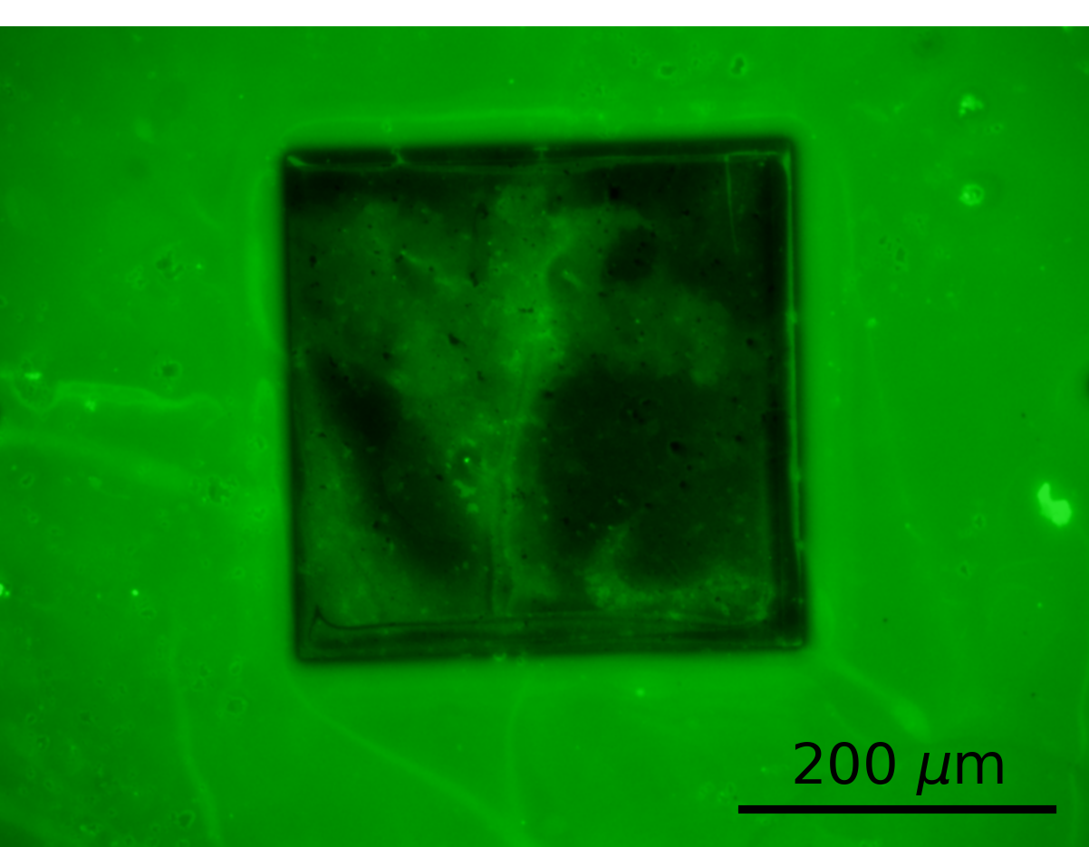
Unencapsulated
region
Cr/Au
CNTs
CNTs
Cr/Au

Slide 13
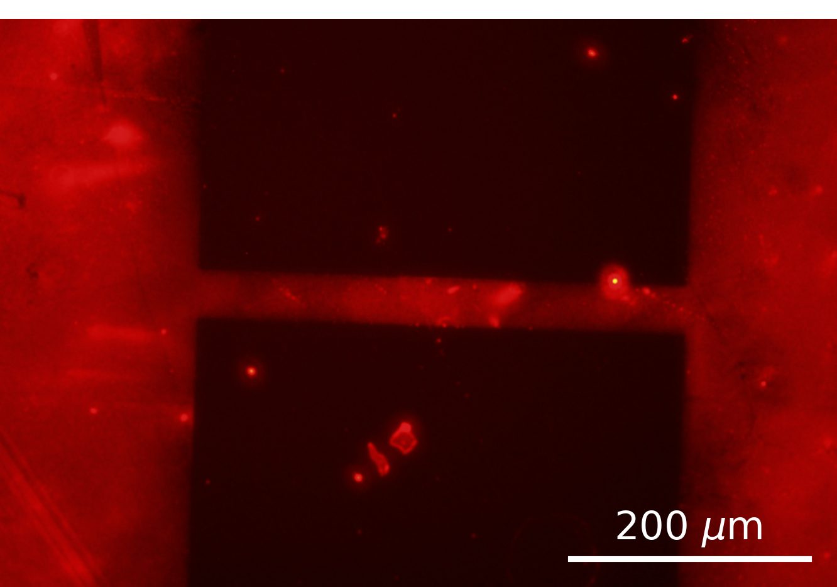
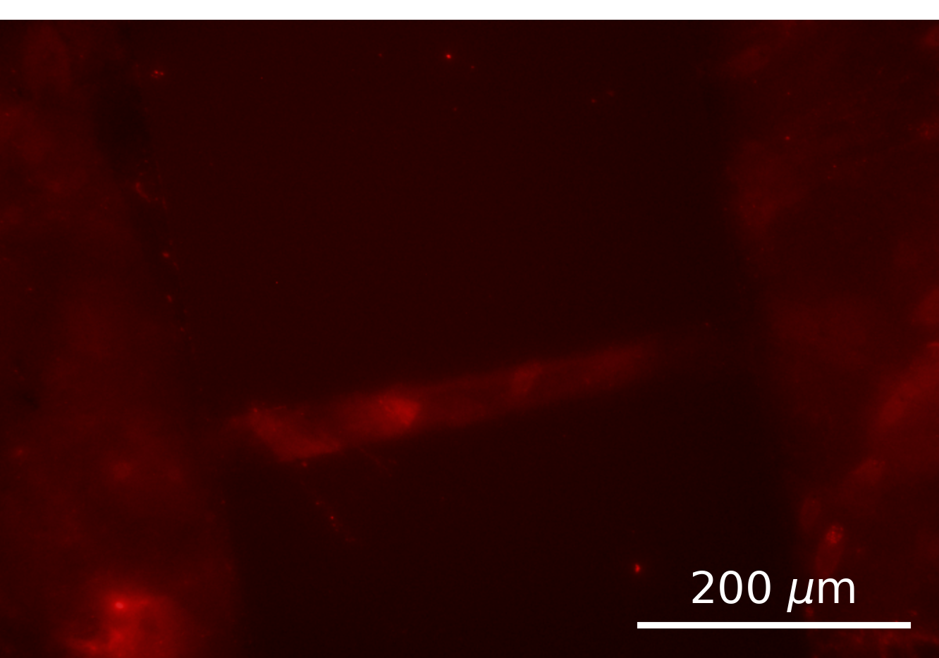
Cr/Au
Cr/Au

